Slide 1
PAPER REPLICATION
Validation accuracy by epoch
Seven saved validation-accuracy curves
Y-axis: validation accuracy • X-axis: epoch
31 August 2026

Slide 2
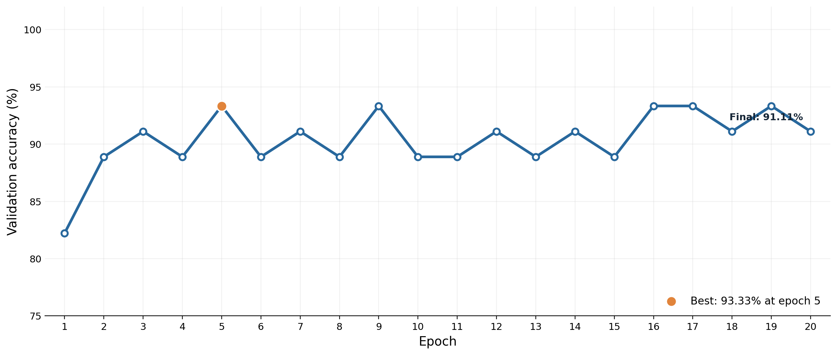
20-EPOCH TRAINING RUN
CNN from scratch
Every saved epoch is shown • 20 epochs • final validation accuracy 91.11%

Slide 3
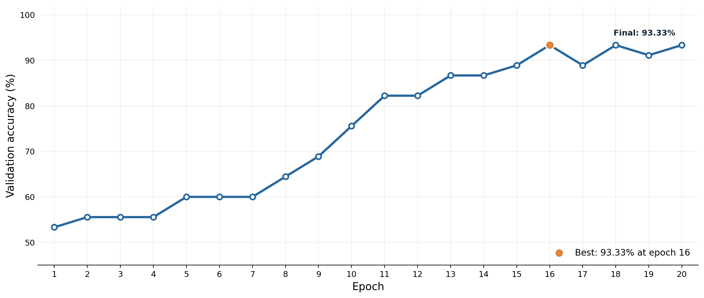
20-EPOCH FROZEN-BACKBONE RUN
ViT-Tiny frozen
Every saved epoch is shown • 20 epochs • final validation accuracy 93.33%

Slide 4
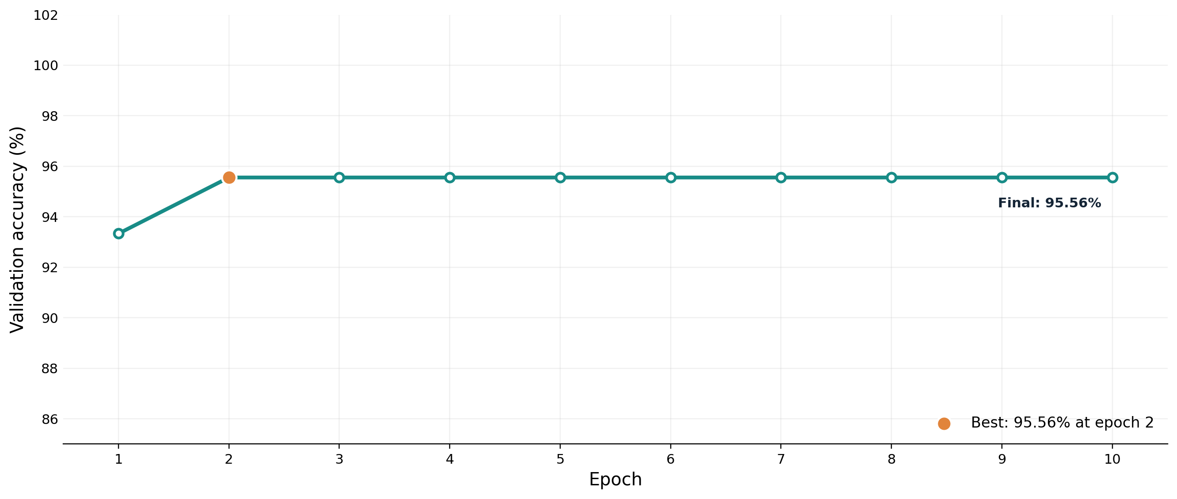
10-EPOCH FINE-TUNING RUN
ViT-Tiny fine-tuned
Every saved epoch is shown • 10 epochs • final validation accuracy 95.56%

Slide 5
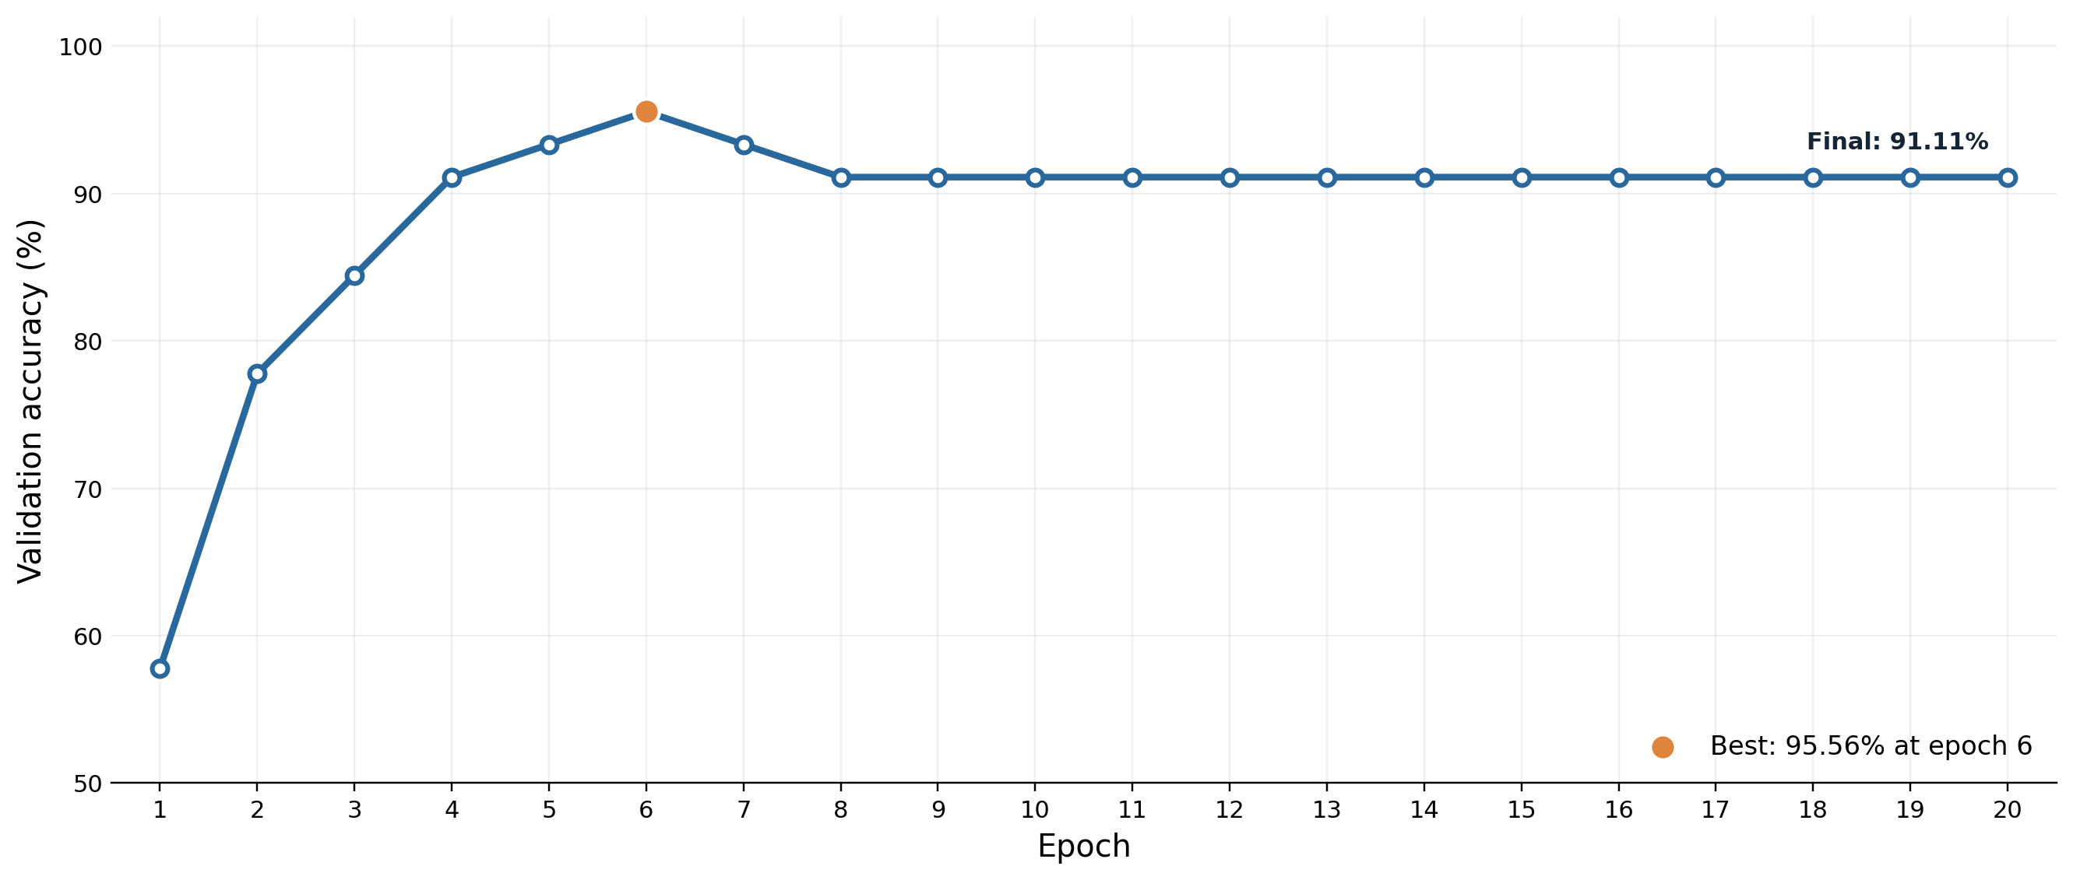
20-EPOCH FROZEN-BACKBONE RUN
DINOv2 frozen
Every saved epoch is shown • 20 epochs • final validation accuracy 91.11%

Slide 6
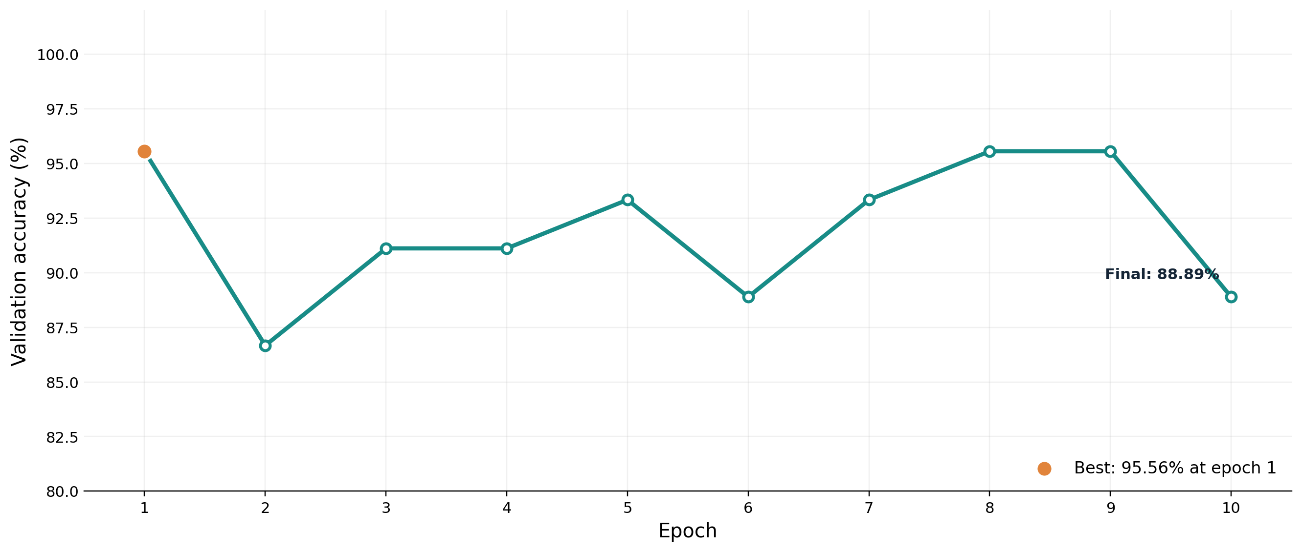
10-EPOCH FINE-TUNING RUN
DINOv2 fine-tuned
Every saved epoch is shown • 10 epochs • final validation accuracy 88.89%

Slide 7
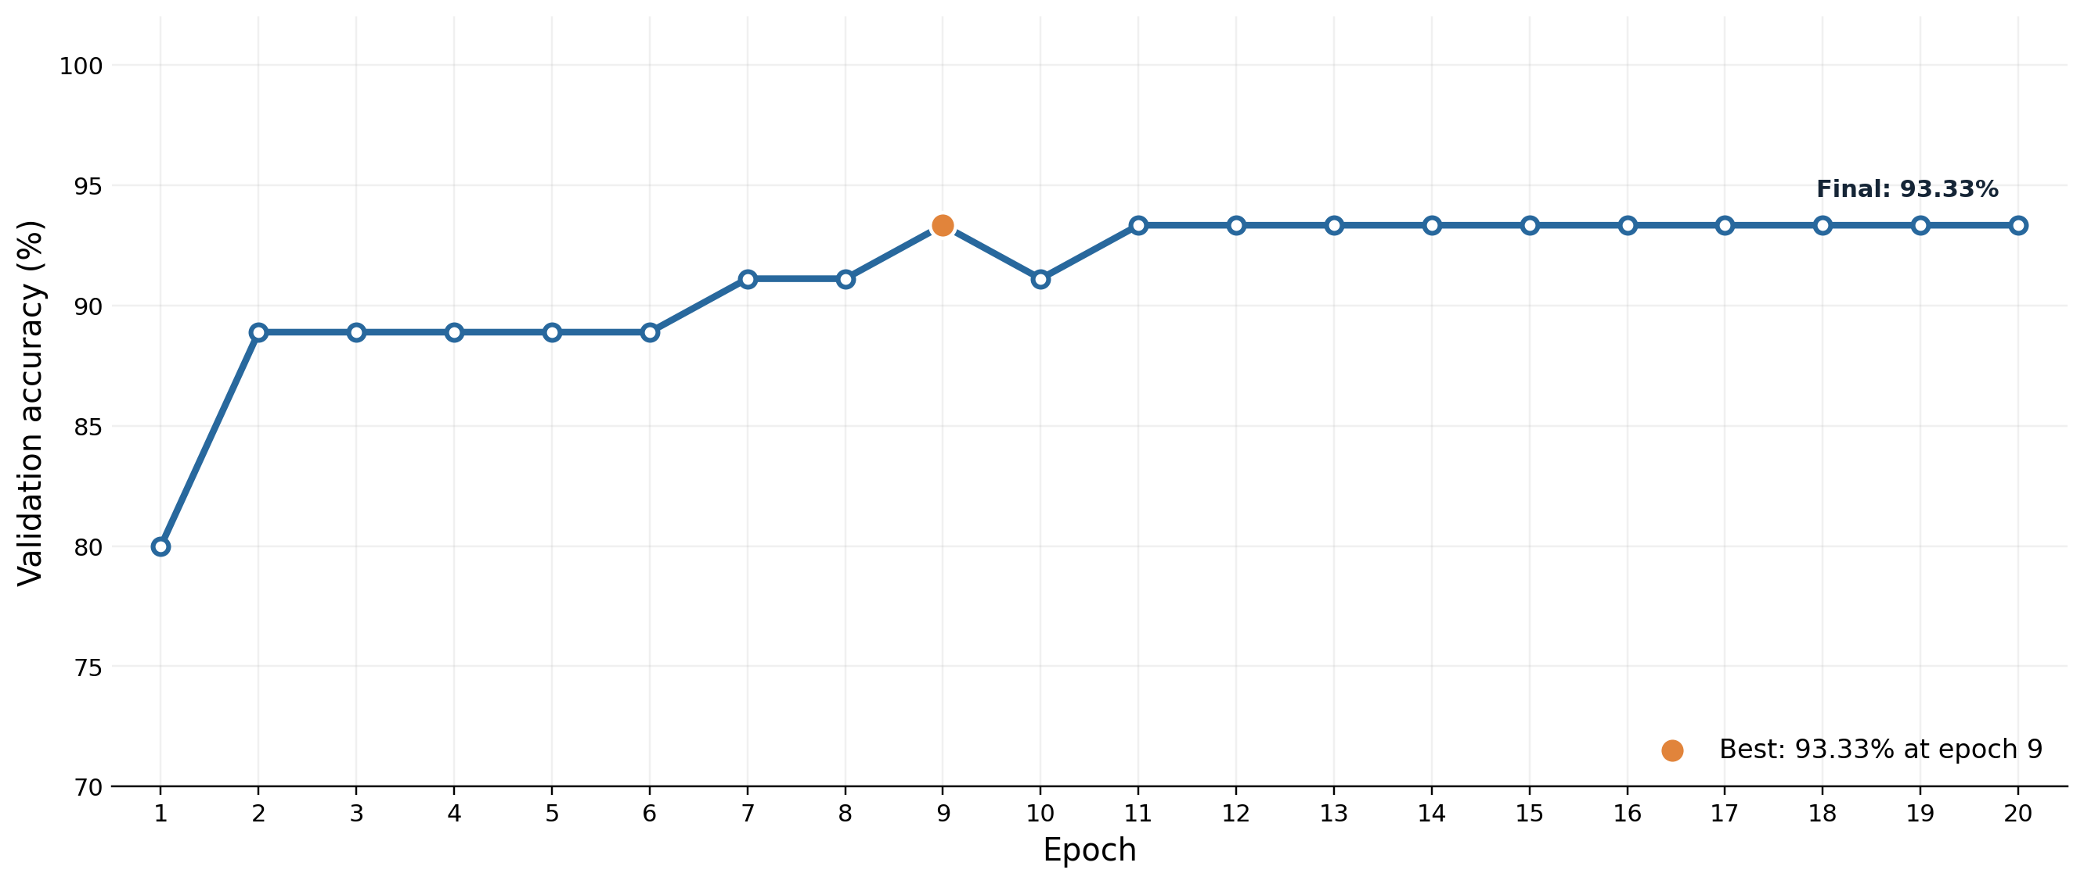
20-EPOCH FROZEN-BACKBONE RUN
VMamba frozen
Every saved epoch is shown • 20 epochs • final validation accuracy 93.33%

Slide 8
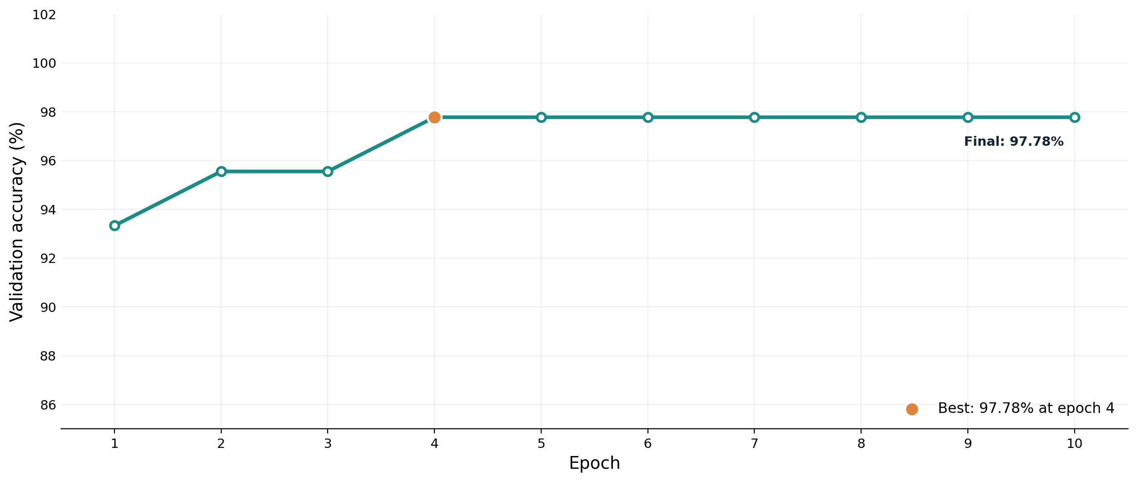
10-EPOCH FINE-TUNING RUN
VMamba fine-tuned
Every saved epoch is shown • 10 epochs • final validation accuracy 97.78%

